Slide 1
Background execution
Developer's Guide to
Windows 10 Insider Preview
Andy & Jerry

Slide 2
Background tasks

Slide 3
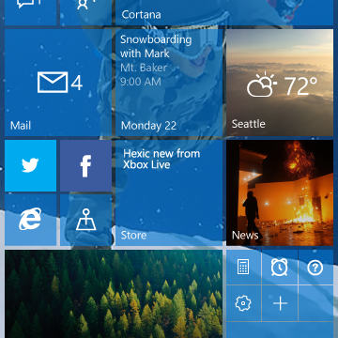

Background Execution
Provide real-time content while suspended
Draw users into your app
Delight them with features

Slide 4
Allowing your app to run when it’s not running

Slide 5
Building a background tasks
Respect cost
BackgroundWorkCostValue.High means the task should not do work
Handling cancelation
Tasks can be cancelled by the app or operating system heuristics
Running in deferral
Background tasks do not have to operate asynchronously
Progress feedback
Progress is a numeric value

Slide 6
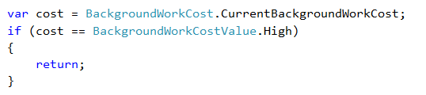
Respecting cost
Querying cost can reduce incomplete operations

Slide 7
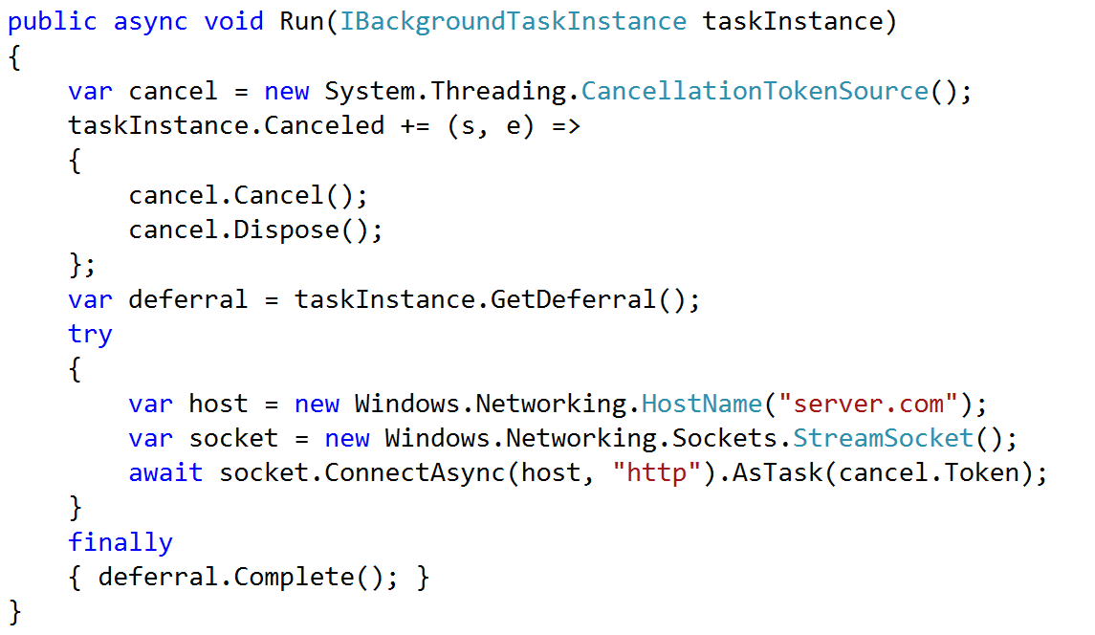
Handling cancelation
Cancellation can result from resource constraints

Slide 8
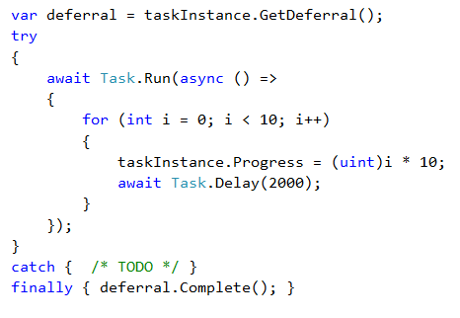
Running in a deferral

Slide 9
An app can have more than one background task

Slide 10
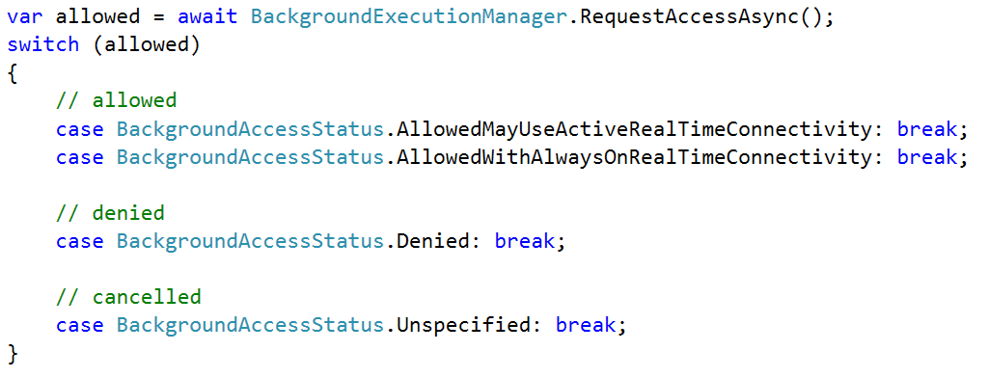
Request Background Permission

Slide 11
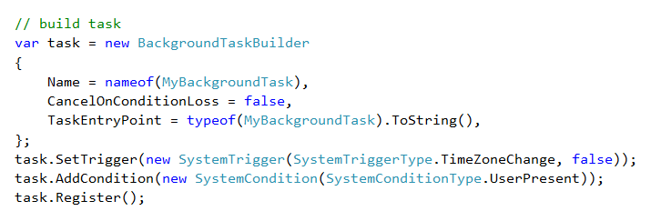
Build & register task

Slide 12
Task execution = Trigger + [Condition(s)]

Slide 13
Background triggers [ when? ]
SystemTrigger
TimeTrigger
MaintenanceTrigger
DeviceUseTrigger
DeviceServicingTrigger
PushNotificationTrigger
AppointmentStoreNotificationTrigger
ContactStoreNotificationTrigger
EmailStoreNotificationTrigger
BluetoothLEAdvertisementWatcherTrigger
BluetoothLEAdvertisementPublisherTrigger
DeviceWatcherTrigger
ActivitySensorTrigger
SensorDataThresholdTrigger
ToastNotificationHistoryChangedTrigger
ToastNotificationActionTrigger
ApplicationTrigger
MediaProcessingTrigger
SocketActivityTrigger
Windows 8.1
Windows 10
CachedFileUpdaterTrigger
DeviceConnectionChangeTrigger
GattCharacteristicNotificationTrigger
RfcommConnectionTrigger
LocationTrigger
Phone 8.1

Slide 14
The time trigger has a 15 minute floor

Slide 15
About the maintenance trigger
Requires A/C power
If unplugged, it will be cancelled
Requires Wi-Fi connection
Requires lock screen access
Is a long-running task
Not guaranteed to run
Can be cancelled
Parameters
Freshness (15 minutes or more)
One shot (repeating)

Slide 16
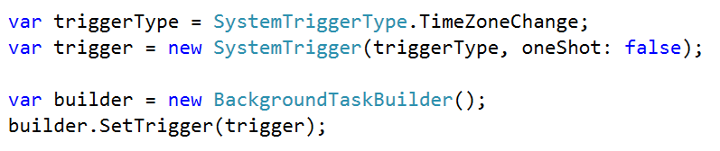
Add a Trigger

Slide 17
Task execution = Trigger + [Condition(s)]

Slide 18
System condition(s) [ if? ]
User Present
If the user is present
User Not Present
If the user is not present
Internet Available
If the internet is available
Internet Not Available
If the internet is not available
Session Connected
If the user is logged in
Session Disconnected
If the user is not logged in
Free Network Available
If a non-metered network is available
Work Cost Not High
If background resources are plentiful

Slide 19
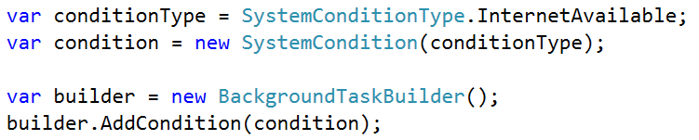
Register with a Condition

Slide 20
Once triggered, tasks wait for all conditions

Slide 21
Managing your Background resources

Slide 22
Task constraints
CPU time quota = NO
CPU guarantee = YES (10%)
Wall clock quota = YES (25s + 5s)
Except for long-running tasks
Memory quota = YES
Variable by device, min 16MB
Network quota = YES
Variable by device

Slide 23
Every time a trigger fires the quota starts over

Slide 24
Resource management
Memory
Default tasks
Guaranteed minimum 25s
Run (25 seconds)
Cancel (5 seconds)
Memory
Long-running tasks
As long as resources are available
Includes: Application, Maintenance, and DeviceUse triggers
Run (no end)
End (no warning, for now)

Slide 25
Background tasks can be cancelled (5 sec) at any time

Slide 26
Host tasks in foreground process
tt
Default process
In process
App Container
Default process
Hosted in separate process
Separate memory cap
App Container
app.exe
app.exe
Core Application
Core Application
In-process
Simplified communication
Shares memory caps
Foreground app starts in app.exe
Background task starts in app.exe
backgroundtaskhost.exe
backgroundtaskhost.exe
Background Task
Background Task

Slide 27
In-process tasks have the same background constraints

Slide 28
Memory implications
Task
Memory limit
Foreground app
Foreground app
Memory
Task
Task
Task
Task
Default process (separate memory)
In-process (combined memory)
Trigger
Trigger
Trigger

Slide 29
When your UI is terminated, so is your in-process task

Slide 30
Configure In-Proc Background Task
<Extension Category="windows.backgroundTasks"
EntryPoint="BackgroundTasks.TimerTask"
Executable="MyApp.exe">

Slide 31
User-invoked constraints
Quiet hours
Only when the user is not using device
No toast occur
No background tasks start
Active tasks are canceled
Still allowed:
VOIP toast
Alarm toast
Battery saver
Users manages apps that can execute
Controls number of tasks (heuristic)
Reveals abusive tasks to the user
User can "exempt" select apps

Slide 32
With battery saver, the back execution manager still returns approved

Slide 33
Debugging background tasks
Visual Studio can trigger
Application log
Application & Services Logs > Microsoft > BackgroundTaskInfrastructure
PowerShell cmdlets
Test with global pool disabled
Set-AppBackgroundTaskResourcePolic –Mode Conservative
See resource usage
Get-AppBackgroundTask -ResourceUsage

